Slide 1
Welcome to MOBCOM @ EURECOM
Instructor: Petros Elia
  http://www.eurecom.fr/people/elia.en.htm
  elia@eurecom.fr
  tel: 0493-00-8132
  Office 329
Class: Room 102, Thursday: 8:45am-12:00
Office Hours: Thursday 12:00-1:00pm: Room 329 (zoom also)

Slide 2
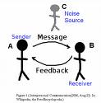
Our focus: How to communicate information?

Slide 3
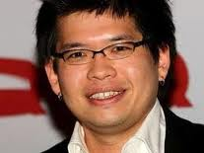
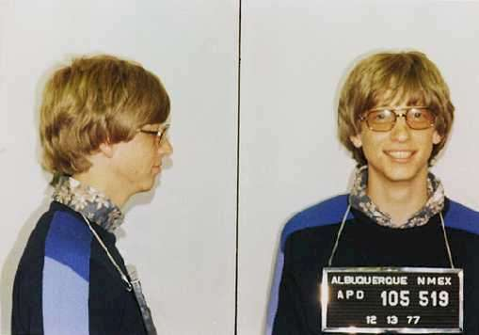
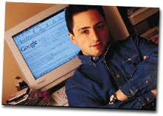
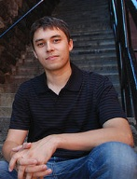
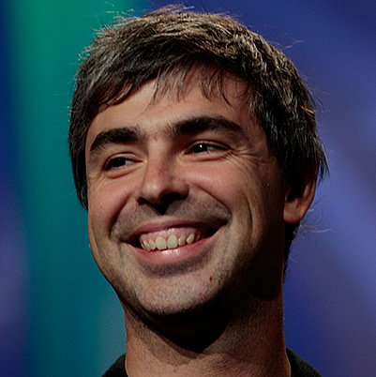

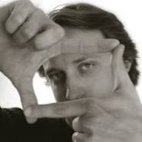
Why is there a massive challenge?
Hint below

Slide 4
Generators of infinite information to properly treat and reliably communicate
Youtube
GOOGLE
MICROSOFT

Slide 5
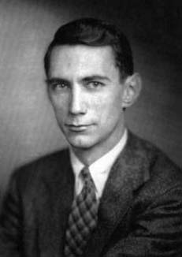
What are some of the tools?
Hint. Who is he?

Slide 6
Father of Information Theory
Helps find limits of information exchange?
Claude Elwood Shannon

Slide 7
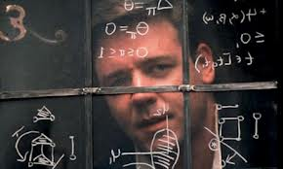
What are some future tools?
Hint – think of Russell Crowe

Slide 8
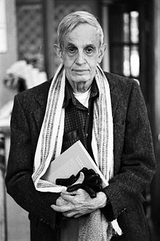
John Nash: Game Theory
How to cooperate with other wireless users

Slide 9

What tool does coffee inspire?

Slide 10
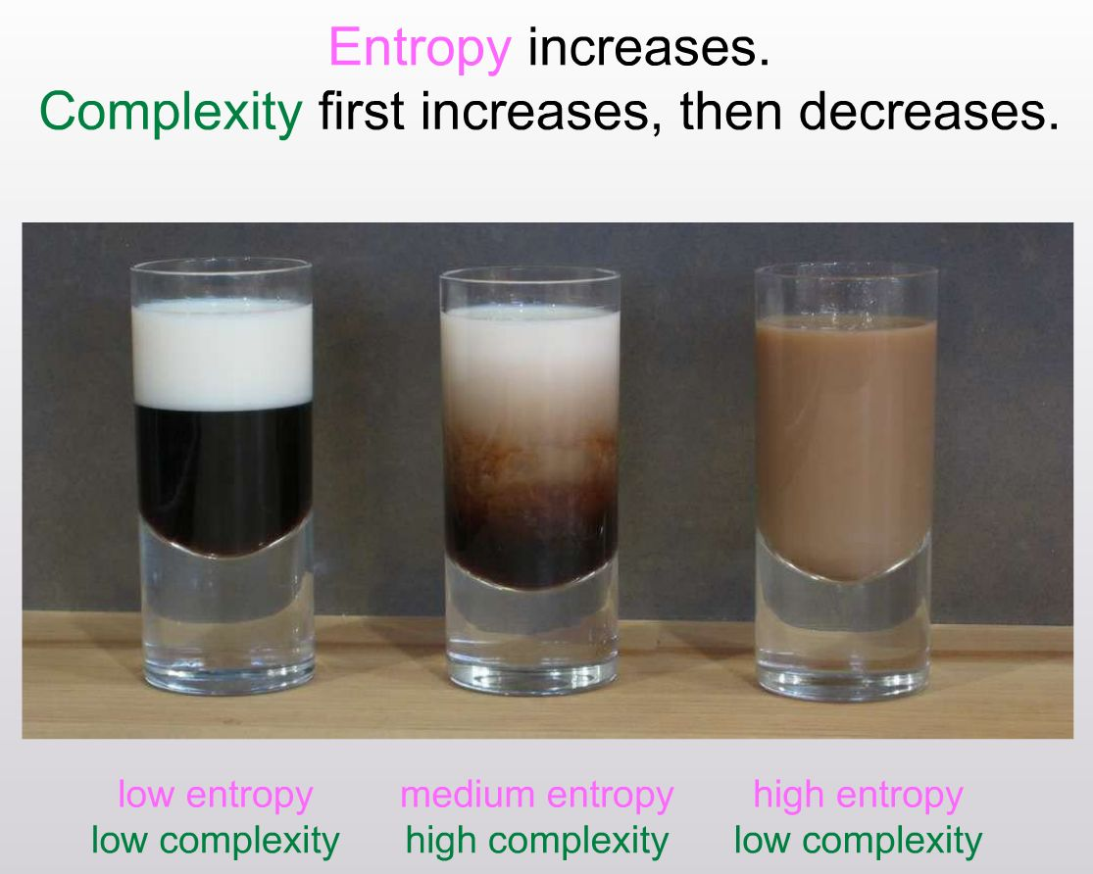
Complexity of communications: Generate signals that behave like … stirred coffee!

Slide 11
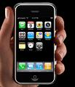
All these come together in the palm of your hand

Slide 12
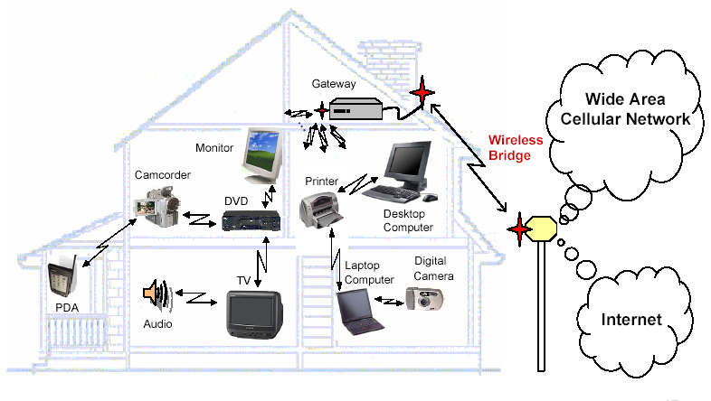
…of many hands
UMTS
WiFi
Short-range wireless network
(Bluetooth, UWB)
Base Station

Slide 13
Why Telecommunications
Fascinating area
  A trillion dollar industry
  challenging research drawing from a plethora of areas
  big picture can pay off in a lot of ways (consulting, research)
Class will lay foundations for mobile communications
  see the big picture
  apply the proper mathematical and physical tools
  gain insight and offer solutions

Slide 14
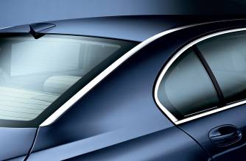



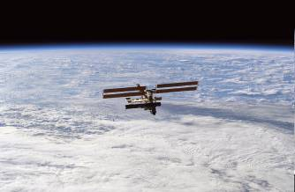

Telecommunication-related careers
AUTOMOTIVE
INFOCOM
TRANSPORT,
ENVIRONMENT &
POWER ENGINEERING
AERONAUTICS
SPACE
DEFENCE &
SECURITY

Slide 15
Why study MOBCOM??
Telecommunications area GROWING FAST:
  Among most active industries
FINANCIALLY REWARDING – INDUSTRY IS WAITING FOR YOU:
  Wireless network architect: FT, Bouygues, SFR,..
  Creating devices: Nokia, Ericsson, Alcatel, Motorola, Siemens…
  Creating new wireless service software (games, positioning, interactive)
  Advancing the theory of information: Research labs
  Management and even … finance
  NO LACK OF JOBS IN THIS AREA!!!
IT IS EXTREMELY INTERESTING

Slide 16
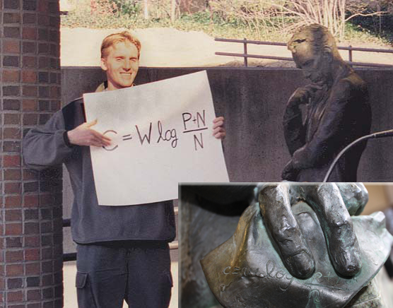
Spirit of MOBCOM
Class meant to offer a broad exposition of the general area of mobile communications
Try to distill a complicated problem, and provide insightful and concise answers

Slide 17
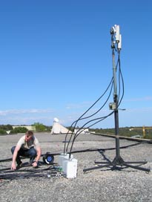
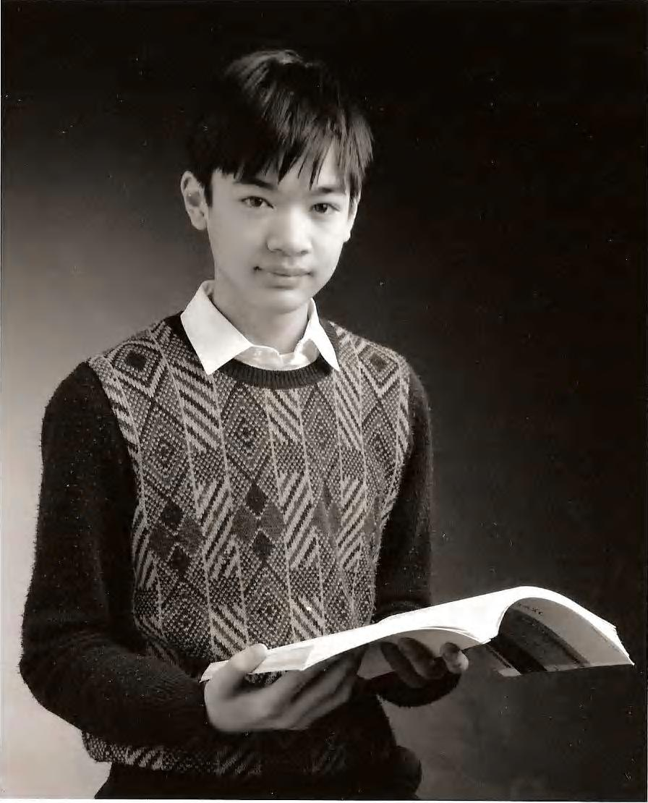
Spirit of MOBCOM
Try to balance theory and practice
  From practical/engineering To Fields Medalist breakthroughs

Slide 18
Now lets focus a bit on the details
Course Soft Pre-requisites:
  probability theory
  random processes
  transform theory
  digital communications
Class Text Book:
  Fundamentals of Wireless Communication, by D. Tse and P. Viswanath, Cambridge University Press, May 2005.
  A leading textbook: unified view of wireless communications process

Slide 19
Details: Grading (tentative – special semester)
Homeworks 10%
MATLAB+Research sessions 25%
Midterm exam (November) 25%
Final exam (February) 40%

Slide 20
Details: Exam
Final Exam
  Two hours long
  Comprehensive
  Class notes allowed
Midterm exam
  (~1 hour)

Slide 21
Details: Course Outline
Physical channel modeling
Detection of signals in fading channels
Single User Communications
  Basic Communication Techniques
  Fundamental Limits
Multiuser Communications
  Basic Communication Techniques
  Fundamental Limits
Coding for achieving Fundamental limits
  Classical Coding + Linear codes
  Convolutional codes
  Polar Codes
  Advanced techniques

Slide 22
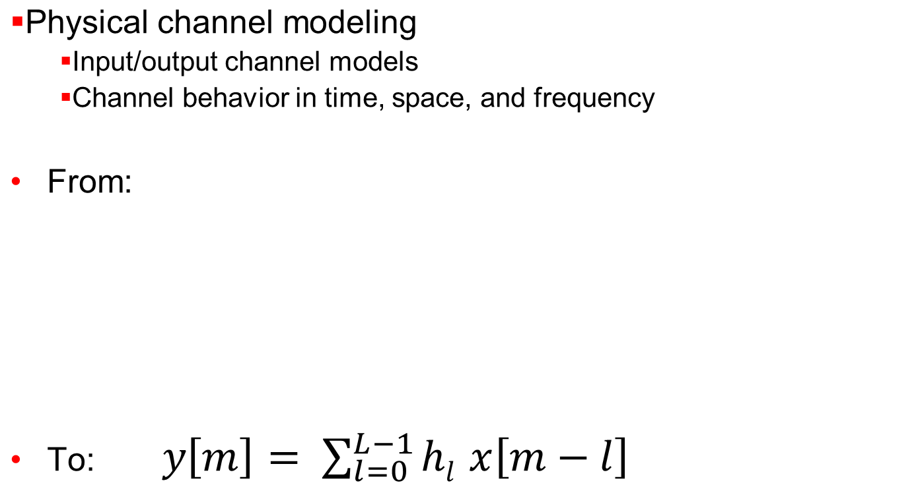
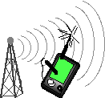
Outline: Physical Channel Modeling

Slide 23
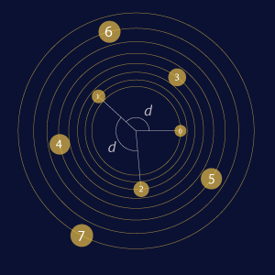
Outline: Detection of signals in fading channels
How to detect what was communicated

Slide 24
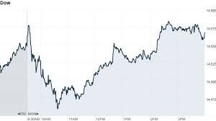
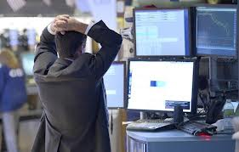
Outline: Communication techniques
How to communicate in the presence of randomness?

Slide 25

Outline: Communication techniques
Will learn how to invest our signals in space/time/frequency

Slide 26
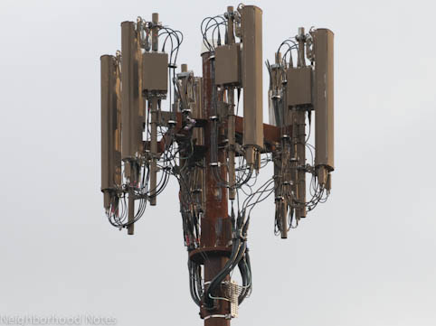
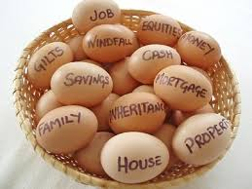

Outline: Communication techniques
Will learn how to invest our signals in space/time/frequency

Slide 27
Outline: Multiuser (Interfering) Communications
Will learn how to accommodate many (interfering) users
UMTS
WiFi
Short-range wireless network
(Bluetooth, UWB)
Base Station

Slide 28
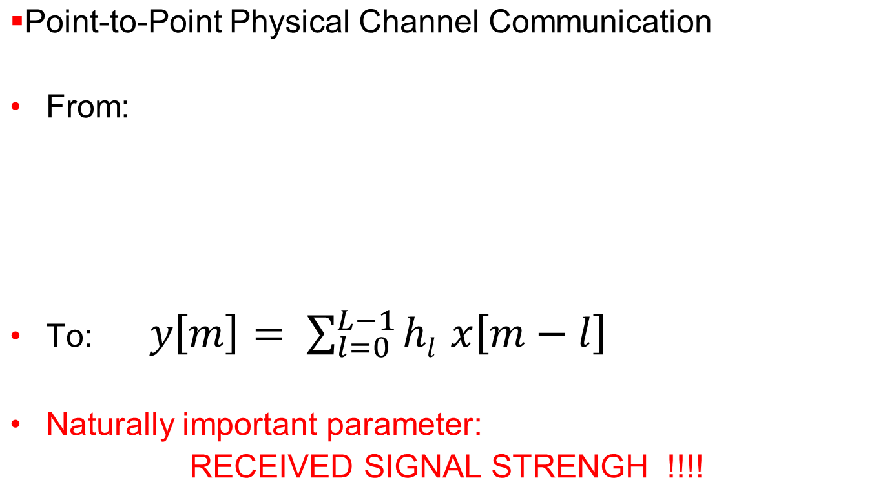
Let us start from the beginning

